Slide 1






Chapter – 2
Python Basics for Data Science
Notes:
Python Basics for Data Science

Slide 2

Disclaimer
The content is curated from online/offline resources and used for educational purpose only

Slide 3

Chapters for Discussion
Python Basics for Data Science
Data Literacy & Analysis
OOPs Concept

Slide 4

Chapter 2.1

Slide 5
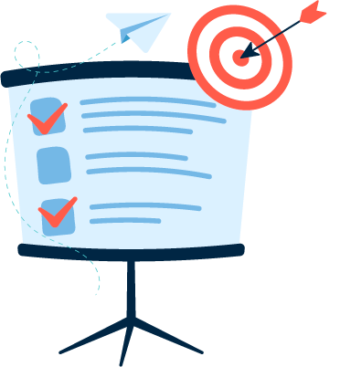
Learning Objective
You will learn in this Chapter:
Understanding of Python syntax
Understanding of data types and operators
Understanding about control and looping statements
Understanding the function
Understanding the file handling
Notes:
Welcome to this chapter! In this session, you'll gain a comprehensive understanding of Python. We'll start by exploring the fundamental concepts of Python, including its features and why it is a preferred programming language. Then, we'll discuss the scope of Python in India, highlighting its growing importance and career opportunities for developers. We'll also delve into the history of Python, tracing its evolution and key milestones. You will learn how to install Python, set up your development environment, and run your first Python script through a practical demonstration. Finally, we'll look at various use cases of Python applications across different industries, showcasing its versatility and real-world applications. This will provide a strong foundation for your journey into Python programming.

Slide 6

Learning Outcome
You will learn in this Chapter:
Understand and apply basic Python syntax to write clean and structured code.
Identify and use different data types and operators effectively in Python programs.
Implement control flow using conditional and looping statements.
Define and use functions to structure and reuse code efficiently.
Perform file handling operations such as reading from and writing to files.
Notes:
You will learn in this Chapter:
Understand and apply basic Python syntax to write clean and structured code.
Identify and use different data types and operators effectively in Python programs.
Implement control flow using conditional and looping statements.
Define and use functions to structure and reuse code efficiently.
Perform file handling operations such as reading from and writing to files.

Slide 7
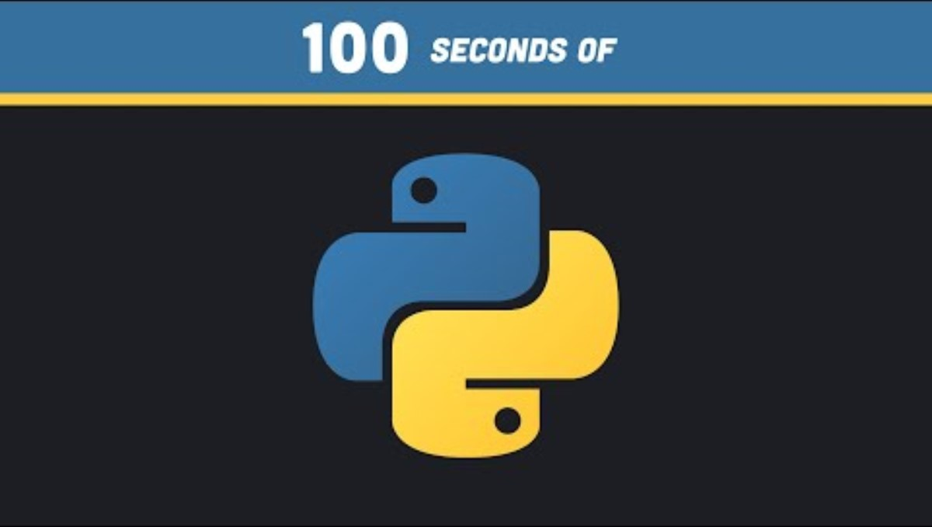
Let’s Play this
Source :
https://www.youtube.com/watch?v=x7X9w_GIm1s
Notes:
Python is a popular, easy-to-learn programming language with a zen-like code structure. It's used for web apps, big data analysis, and machine learning. It's strongly typed, but dynamic, and uses indentation instead of semicolons. It's multi-paradigm and has a large ecosystem of third-party libraries.

Slide 8
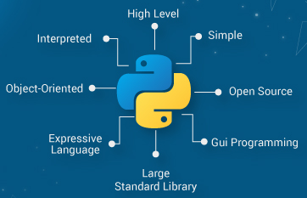
What is Python ?
Python is an interpreted, object-oriented, high-level programming language with dynamic semantics.
Source :
https://www.edureka.co/blog/python-features/
Notes:
Let's Discuss, What is python?
Python is a widely used programming language that offers several unique features and advantages compared to languages like Java and C++. Our Python tutorial thoroughly explains Python basics and advanced concepts, starting with installation, conditional statements, loops, built-in data structures, Object-Oriented Programming, Generators, Exception Handling, Python RegEx, and many other concepts.
Key Features of Python:
Readability:
Python emphasizes clear and readable syntax, making it easier for developers to write and maintain code.
Interpreted Language:
Python code is executed line-by-line by an interpreter, which makes debugging easier but can be slower than compiled languages.
Versatility:
Python supports multiple programming paradigms, including procedural, object-oriented, and functional programming.
Extensive Standard Library:
Python comes with a vast standard library that includes modules and packages for various tasks like web development, data analysis, and machine learning.
Cross-Platform:
Python is available on multiple operating systems, including Windows, macOS, and Linux, making it highly portable.
Community Support:
Python has a large and active community that contributes to a wealth of third-party libraries, frameworks, and tools, as well as extensive documentation
Common Uses of Python:
Web Development:
Frameworks like Django and Flask are used for building web applications.
Data Science and Machine Learning:
Libraries like Pandas, NumPy, SciPy, and Scikit-Learn are popular for data analysis and machine learning tasks.
TensorFlow and PyTorch are widely used for deep learning.
Scripting and Automation:
Python is often used for writing scripts to automate repetitive tasks and for system administration.
Software Development:
Python is used to develop a wide range of software applications, from simple scripts to complex enterprise solutions.
Game Development:
Libraries like Pygame allow for game development.

Slide 9
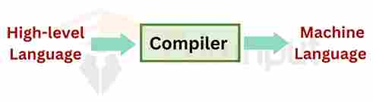
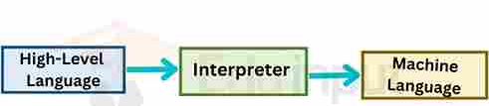
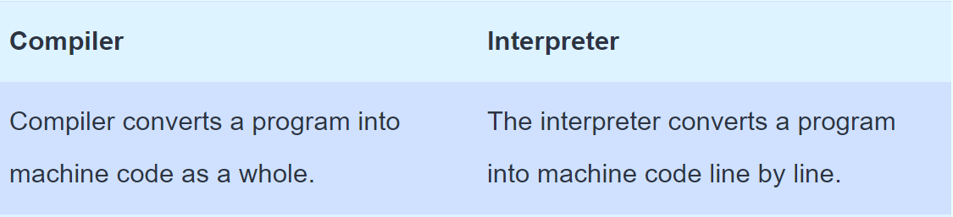
What are Compilers and Interpreters? Why?
Source :
https://www.guru99.com/compiler-design-tutorial.html
Notes:
Compilers and interpreters are tools used to translate high-level programming languages into machine code. A compiler translates the entire program into machine code before execution, which often results in faster execution but requires a complete program to be processed first. An interpreter, on the other hand, translates code line-by-line during execution, which makes it more flexible and easier to debug, though it may be slower compared to compiled code. Both are essential for executing and testing code in various programming environments.

Slide 10
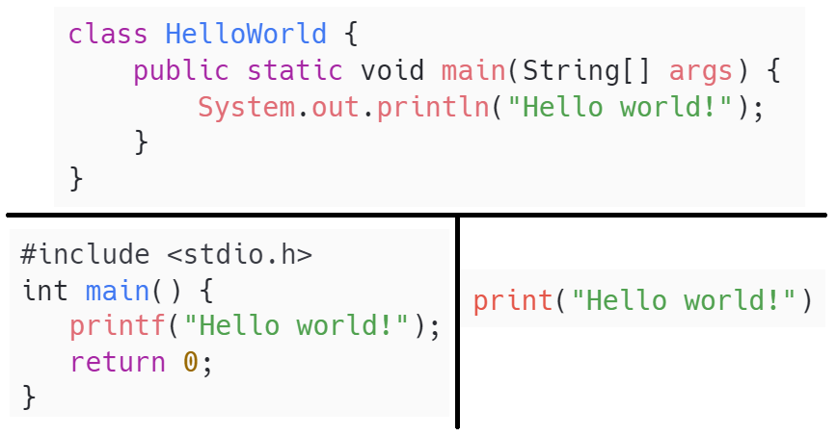
The rise of the Python Programming Language
Source :
https://www.megatrend.com/en/the-rise-of-the-python-programming-language/
Notes:
Tell students to identify the code snippet belongs to which programming language and output as well. So that we can interact with students and make them understand the importance of Python lamheage.

Slide 11
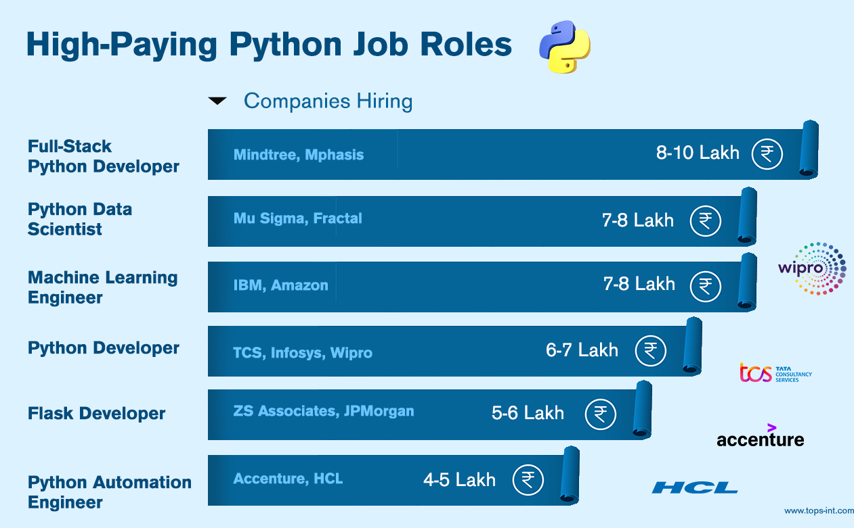
Scope of Python Language in India
Python's acceptance and growth in recent years in India.
The causes of its ubiquity and applications in many disciplines.
Python programming job possibilities in India.
Future prospect of Python in India
Source :
https://admin.tops-int.com/storage/media/editor_images/62858.jpg
Notes:
Python is a versatile programming language, and proficiency in Python opens up a wide range of job opportunities in various fields. Here are some common job roles that require Python skills, along with brief descriptions of each:
1. Python Developer
Description:
Python developers write server-side web application logic. They often work on developing back-end components, connecting applications with third-party web services, and supporting front-end developers by integrating their work with the Python application.
Skills:
Proficiency in Python
Experience with web frameworks like Django or Flask
Knowledge of front-end technologies (HTML, CSS, JavaScript)
Understanding of databases and SQL
2. Data Scientist
Description:
Data scientists analyze and interpret complex data to help companies make decisions. They use Python for data analysis, statistical modeling, and data visualization.
Skills:
Proficiency in Python and data science libraries (Pandas, NumPy, Scikit-Learn)
Experience with data visualization tools (Matplotlib, Seaborn)
Knowledge of statistical analysis and machine learning
Strong analytical and problem-solving skills
3. Machine Learning Engineer
Description:
Machine learning engineers design, build, and deploy machine learning models. They use Python to implement algorithms, process data, and evaluate model performance.
Skills:
Proficiency in Python and machine learning libraries (TensorFlow, PyTorch, Scikit-Learn)
Understanding of machine learning algorithms and techniques
Experience with data preprocessing and feature engineering
Knowledge of deployment tools and frameworks
4. Data Analyst
Description:
Data analysts collect, process, and perform statistical analyses on data. They use Python to clean, analyze, and visualize data, and to generate reports that help guide business decisions.
Skills:
Proficiency in Python and data analysis libraries (Pandas, NumPy)
Experience with data visualization tools (Matplotlib, Seaborn, Plotly)
Strong analytical skills and attention to detail
Knowledge of SQL and database management
5. DevOps Engineer
Description:
DevOps engineers work on bridging the gap between software development and IT operations. They use Python for automation, configuration management, and deployment processes.
Skills:
Proficiency in Python for scripting and automation
Experience with CI/CD tools (Jenkins, GitLab CI)
Knowledge of containerization (Docker, Kubernetes)
Understanding of cloud platforms (AWS, Azure, GCP)
6. Software Engineer
Description:
Software engineers design, develop, and maintain software applications. Python is often used for various software engineering tasks, from web development to automation.
Skills:
Proficiency in Python and software development practices
Experience with software development frameworks and libraries
Knowledge of algorithms and data structures
Strong problem-solving and debugging skills
7. Full-Stack Developer
Description:
Full-stack developers work on both the front-end and back-end of web applications. They use Python for server-side development and integrate it with front-end technologies.
Skills:
Proficiency in Python and web frameworks (Django, Flask)
Knowledge of front-end technologies (HTML, CSS, JavaScript, React, Angular)
Experience with databases and server management
Ability to work on both client and server sides
8. Cybersecurity Analyst
Description:
Cybersecurity analysts protect an organization's computer systems and networks. They use Python for writing scripts to automate tasks, analyze logs, and identify security threats.
Skills:
Proficiency in Python for scripting and automation
Knowledge of cybersecurity principles and practices
Experience with security tools and frameworks
Strong analytical and problem-solving skills
9. Automation Engineer
Description:
Automation engineers develop automated solutions to increase efficiency and reduce human intervention. They use Python for writing scripts and developing automation tools.
Skills:
Proficiency in Python for scripting and automation
Experience with automation tools and frameworks
Understanding of software development and testing processes
Strong problem-solving skills
10. Financial Analyst
Description:
Financial analysts evaluate financial data to assist in investment decisions. They use Python for data analysis, financial modeling, and automation of reporting tasks.
Skills:
Proficiency in Python for data analysis and financial modeling
Knowledge of financial principles and markets
Experience with data visualization and reporting tools
Strong analytical and quantitative skills
Job Hunting Tips
Build a Strong Portfolio: Showcase your Python projects on platforms like GitHub.
Certifications and Courses: Consider obtaining certifications in Python, data science, or machine learning.
Networking: Join Python communities, attend meetups, and participate in forums like Stack Overflow.
Stay Updated: Keep up with the latest trends and developments in Python and related technologies.
These roles demonstrate the broad applicability of Python across different industries and job functions. Whether you're interested in web development, data science, automation, or cybersecurity, Python skills can significantly enhance your career prospects.

Slide 12
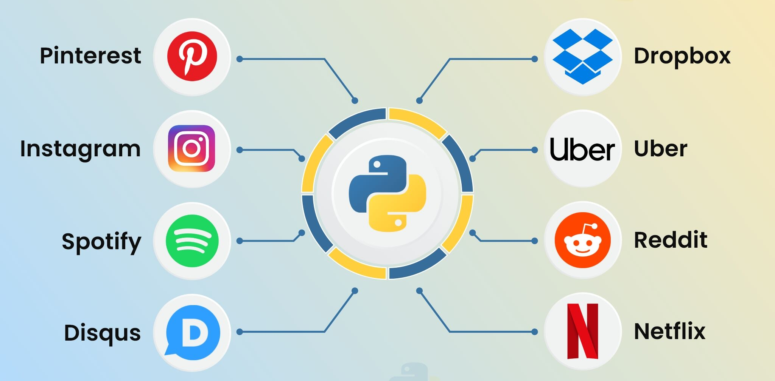
Use case of Python Applications
Source :
https://www.apptunix.com/blog/wp-content/uploads/sites/3/2021/08/popular-apps-doveloped-with-python.jpg
Notes:
Let's discuss Use case of Python Applications
------------------------------------------------------------------------------------------------------------------------------------------------------------------------
Web Development
Frameworks:
Django: A high-level web framework that enables rapid development and clean, pragmatic design. It's used for building large-scale applications with complex requirements.
Flask: A micro-framework that is lightweight and flexible, suitable for small to medium-sized applications.
Applications:
E-commerce Platforms: Websites like Shopify and Instagram use Django for their backend.
Content Management Systems: Systems like Wagtail and Mezzanine are built on top of Django.
2. Data Science and Analytics
Libraries:
Pandas: Provides data structures and data analysis tools.
NumPy: Supports large, multi-dimensional arrays and matrices.
Matplotlib and Seaborn: For data visualization.
Applications:
Exploratory Data Analysis (EDA): Analyzing datasets to summarize their main characteristics.
Data Visualization: Creating charts, plots, and graphs to visualize data insights.
Statistical Analysis: Performing complex statistical computations.
3. Machine Learning and Artificial Intelligence
Libraries:
Scikit-Learn: A library for traditional machine learning algorithms.
TensorFlow and Keras: For deep learning and neural networks.
PyTorch: Another deep learning library known for its flexibility.
Applications:
Predictive Modeling: Predicting future trends based on historical data.
Image and Speech Recognition: Applications in facial recognition, voice assistants, etc.
Natural Language Processing (NLP): Chatbots, sentiment analysis, and language translation.
4. Automation and Scripting
Libraries:
Selenium: For automating web browser interactions.
BeautifulSoup: For web scraping and parsing HTML/XML documents.
PyAutoGUI: For automating GUI tasks.
Applications:
Web Scraping: Extracting data from websites for analysis.
Task Automation: Automating repetitive tasks such as file management.
Testing Automation: Automating software testing processes.
5. Scientific Computing
Libraries:
SciPy: For scientific and technical computing.
SymPy: For symbolic mathematics.
Astropy: For astronomy-related calculations.
Applications:
Simulations: Running simulations for scientific experiments.
Complex Mathematical Calculations: Solving advanced mathematical problems.
Research and Development: Supporting scientific research with computational tools.
6. Game Development
Libraries:
Pygame: A set of Python modules designed for writing video games.
Godot (with GDScript, similar to Python): A popular game engine that supports Python-like scripting.
Applications:
2D and 3D Games: Developing interactive games and simulations.
Prototyping Game Mechanics: Quickly testing and iterating on game ideas.
7. Desktop Applications
Libraries:
Tkinter: The standard GUI toolkit for Python.
PyQt and PySide: For creating cross-platform desktop applications with Qt.
Kivy: For developing multi-touch applications.
Applications:
User Interfaces: Building user-friendly interfaces for software applications.
Cross-Platform Applications: Developing software that runs on multiple operating systems.
8. Network Programming
Libraries:
Socket: For low-level network communication.
Twisted: An event-driven networking engine.
Requests: For making HTTP requests.
Applications:
Network Servers and Clients: Building applications that communicate over a network.
Chat Applications: Implementing messaging systems.
Custom Protocols: Developing and implementing network protocols.
9. Cybersecurity
Libraries:
Scapy: For network packet manipulation.
Paramiko: For SSH and SFTP.
PyCrypto: For cryptographic operations.
Applications:
Penetration Testing: Identifying and exploiting vulnerabilities in systems.
Network Analysis: Monitoring and analyzing network traffic.
Cryptography: Implementing encryption and decryption algorithms.

Slide 13
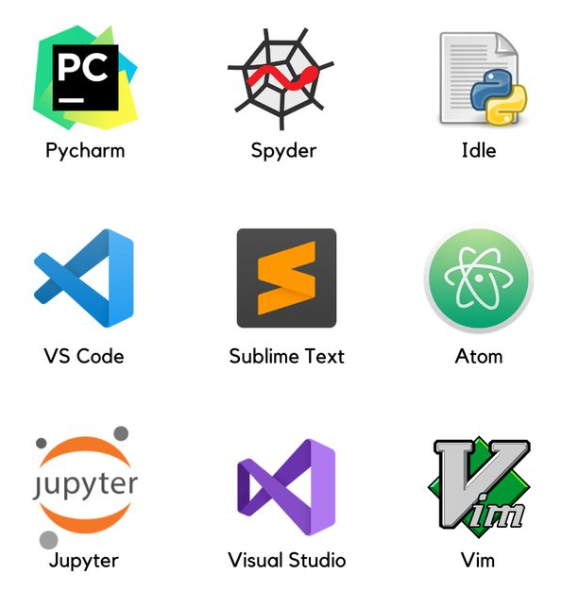
Python IDEs
IDE components include; code editors, compilers, debuggers, interpreters, and a graphical user interface (GUI).
By combining all these different components into a single program, IDE software can help simplify the development process and make it easier for developers to find and fix errors quickly.
Source :
https://goodfangsm.life/product_details/2982567.html
Notes:
IDEs in Python:
IDE components include; code editors, compilers, debuggers, interpreters, and a graphical user interface (GUI).
By combining all these different components into a single program, IDE software can help simplify the development process and make it easier for developers to find and fix errors quickly.

Slide 14

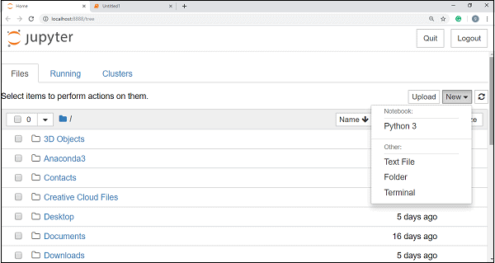
Anaconda & Jupyter
Jupyter Notebook is a web-based interactive computational environment for creating Jupyter notebook documents that supports several languages like Python, R, etc., and is largely used for data analysis, data visualization, and more. Also, it is a cloud-based, open-source tool useful for programmers just starting with data science.
Install - Anaconda
Download Anaconda Distribution - https://anaconda.com/
Install Anaconda - double-clicking the .exe fil
Source :
https://www.linkedin.com/pulse/jupyter-notebook-vs-anaconda-choosing-right-tool-beginners-singh-snysc
Notes:
Imagine you’re setting up a grand toolkit for data science and machine learning. Anaconda is that all-in-one toolkit, a free and open-source distribution of the Python languages specifically designed for these applications. Whether you’re working on Windows, Linux, or macOS, Anaconda can be your trusty companion.
Think of Conda as the manager of this grand toolkit. It's an open-source, cross-platform package management system that helps you keep everything organized. With Anaconda, you get a suite of powerful tools, including JupyterLab, Jupyter Notebook, Spyder, Glueviz, and Visual Studio Code, all ready to help you create and analyze data."
Advantages:
Let's delve into the perks of using Anaconda. Imagine you're an artist with a palette of colors and tools to create a masterpiece. Jupyter, one of Anaconda’s tools, supports markdown and allows you to embed HTML elements, from images to videos, making your work rich and interactive.
Anaconda doesn’t stop there. It offers features for data cleaning and transformation, numerical simulation, statistical modeling, and data visualization. It’s like having a magic wand that transforms raw data into meaningful insights. You can even edit snippets before running them, ensuring your code is perfect before execution. This makes your data analysis not only powerful but also interactive and engaging.
Setting up Anaconda is like preparing your workspace with all the necessary tools. Here’s how you can do it:
Download the Anaconda installer: Start by downloading the installer for your operating system.
Launch the installer: Go to your Downloads folder and double-click the installer. Remember, to avoid permission errors, do not launch it from the Favorites folder.
Follow the installation steps: Click 'Next' to proceed, read and agree to the licensing terms.
Choose installation options: It’s recommended to install Anaconda just for your user account to avoid any permission issues. If you need to install it for all users on the computer, you’ll need Windows Administrator privileges.
Select the destination folder: Choose a directory path without spaces or unicode characters for the installation.
Each step is like setting up different sections of your workspace, ensuring everything is in place for a smooth start.

Slide 15


Lab Activity: Class Work
Lab 1: Learn how to create and manage a repository on GitHub to enhance collaborative software development.
Notes:
Lab: Demonstrating Installation of Anaconda and Set up the Python Environment
Solution: GitHub Link

Slide 16
Lab Activity: Class Work
Lab 2: Demonstrating Installation of Anaconda and Set up the Python Environment
Notes:
Lab: Demonstrating Installation of Anaconda and Set up the Python Environment
Solution: GitHub Link

Slide 17
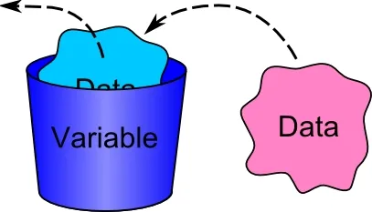
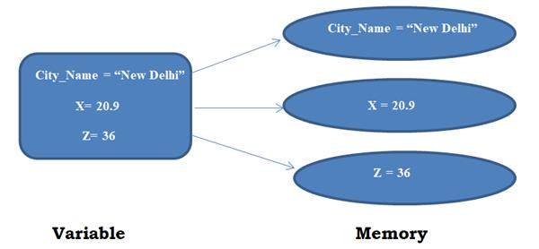
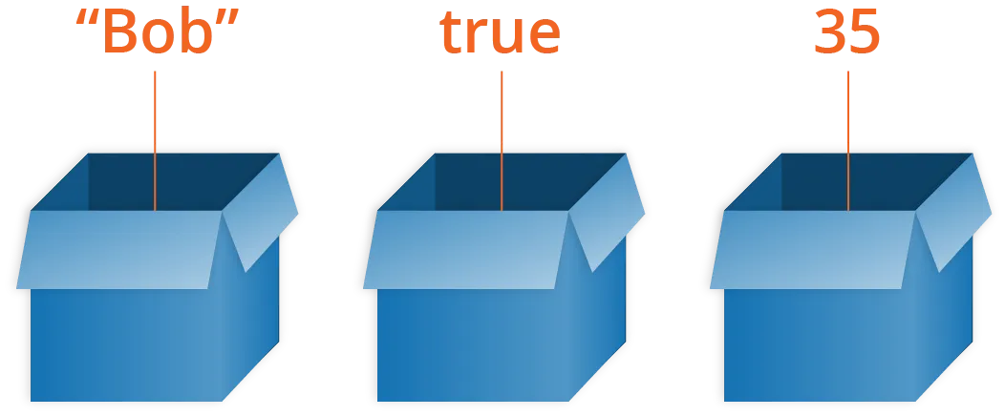
Variables
Source :
https://medium.com/@ngohongphuc2001/python-variables-18b27e6cccd8
Notes:
I hope all of you knew about what is a variable right, without making you bore on this, let me give you a brief about what is variable and we will move to the rest of the topics
----------------------------------
Variable is a storage location with symbolic name, which can be used to store information to be manipulated in our program. In other word, variable is a container that contains different kinds types of data. You can think of variable as a box that you can put stuffs inside it so as to use them afterward.

Slide 18

Activity Time: List out the Variables
1) A company's profit for the first quarter was Rs. 50,000, for the second quarter was Rs. 75,000, for the third quarter was Rs. 60,000, and for the fourth quarter was Rs. 65,000. What was the total profit for the year?
2) You have a string password with the value "Secure123". Check if the password length is at least 8 characters.
3) A student named "Alice" scored 85 in Math and 90 in Science. Create a string that says "Alice scored 85 in Math and 90 in Science."
4) The price of a notebook is Rs. 45. A student buys 8 notebooks and gives a Rs. 500 note to the cashier. How much change will the student get back?
Notes:
Kindly ask students to do this activity on their notebook (running notes) itself. The will come up with different answers and you can verify.
Answer1:
profit_q1 = 50000
profit_q2 = 75000
profit_q3 = 60000
profit_q4 = 65000
total_profit = profit_q1 + profit_q2 + profit_q3 + profit_q4
print(total_profit) # Output: 250000
Answer 2:
password = "Secure123"
is_valid_length = len(password) >= 8
print(is_valid_length) # Output: True
Answer3:
name = "Alice"
math_score = 85
science_score = 90
result = f"{name} scored {math_score} in Math and {science_score} in Science."
print(result) # Output: Alice scored 85 in Math and 90 in Science.
Answer4:
price_per_notebook = 45
number_of_notebooks = 8
total_cost = price_per_notebook * number_of_notebooks
amount_given = 500
change = amount_given - total_cost
print(change) # Output: 140

Slide 19
Lab Activity: Class Work
Lab 3: Demonstrate how to assign variables and use them.
Notes:
Lab: Demonstrate how to assign variables and use them.
Solution: GitHub Link

Slide 20
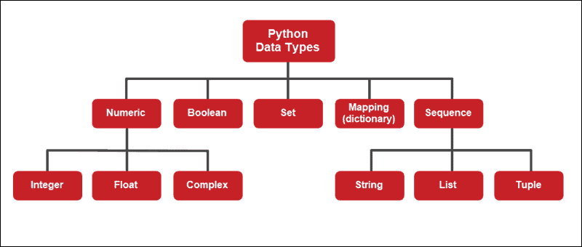
Datatypes in Python
It represents the kind of value that tells what operations can be performed on a particular data.
To check variable’s data types we use the type() function.
Source :
https://phoenixnap.com/kb/python-data-types
Notes:
Let's see what is the data type in Python. And the type of different data types available in Python. And to know the data type of the variable in Python we can use "type()" function in Python to know the datatype of the variable.
A data type is a characteristic that tells the compiler (or interpreter) how a programmer intends to use the data. Variables store different types of data. Creating a variable of a particular data type creates an object of a data type class. The Python interpreter automatically assumes a type when creating a variable.
The data type of any object is found using the built-in type() function. The output shows the name of the class for the given object.

Slide 21
Activity Time: List out the Type of Variables
1) A company's profit for the first quarter was Rs. 50,000, for the second quarter was Rs. 75,000, for the third quarter was Rs. 60,000, and for the fourth quarter was Rs. 65,000. What was the total profit for the year?
2) You have a string password with the value "Secure123". Check if the password length is at least 8 characters.
3) A student named "Alice" scored 85 in Math and 90 in Science. Create a string that says "Alice scored 85 in Math and 90 in Science."
4) The price of a notebook is Rs. 45. A student buys 8 notebooks and gives a Rs. 500 note to the cashier. How much change will the student get back?
Notes:
Kindly ask students to do this activity on their notebook (running notes) itself. The will come up with different answers and you can verify.
Answer1:
profit_q1 = 50000
profit_q2 = 75000
profit_q3 = 60000
profit_q4 = 65000
total_profit = profit_q1 + profit_q2 + profit_q3 + profit_q4
print(total_profit) # Output: 250000
Answer 2:
password = "Secure123"
is_valid_length = len(password) >= 8
print(is_valid_length) # Output: True
Answer3:
name = "Alice"
math_score = 85
science_score = 90
result = f"{name} scored {math_score} in Math and {science_score} in Science."
print(result) # Output: Alice scored 85 in Math and 90 in Science.
Answer4:
price_per_notebook = 45
number_of_notebooks = 8
total_cost = price_per_notebook * number_of_notebooks
amount_given = 500
change = amount_given - total_cost
print(change) # Output: 140

Slide 22
Lab Activity: Class Work
Lab 4: Exploring Data Types in Python
Notes:
Lab: Exploring Data Types in Python
Solution: GitHub Link

Slide 23
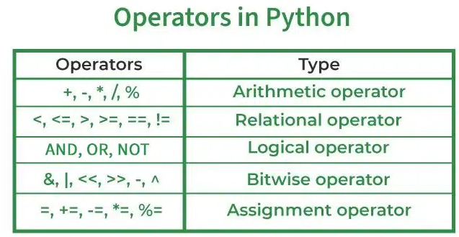
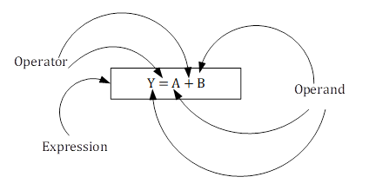
Python Operators
Operators in general are used to perform operations on values and variables.
Source :
https://www.geeksforgeeks.org/python-operators/
Notes:
In Python programming, Operators in general are used to perform operations on values and variables. These are standard symbols used for logical and arithmetic operations. In this article, we will look into different types of Python operators.
OPERATORS: These are the special symbols. Eg- + , * , /, etc.
OPERAND: It is the value on which the operator is applied.

Slide 24
Activity Time: Answer the Questions by using Appropriate Operator
1) A company's profit for the first quarter was Rs. 50,000, for the second quarter was Rs. 75,000, for the third quarter was Rs. 60,000, and for the fourth quarter was Rs. 65,000. What was the total profit for the year?
2) You have a string password with the value "Secure123". Check if the password length is at least 8 characters.
3) A student named "Alice" scored 85 in Math and 90 in Science. Create a string that says "Alice scored 85 in Math and 90 in Science."
4) The price of a notebook is Rs. 45. A student buys 8 notebooks and gives a Rs. 500 note to the cashier. How much change will the student get back?
Notes:
Kindly ask students to do this activity on their notebook (running notes) itself. The will come up with different answers and you can verify.
Answer1:
profit_q1 = 50000
profit_q2 = 75000
profit_q3 = 60000
profit_q4 = 65000
total_profit = profit_q1 + profit_q2 + profit_q3 + profit_q4
print(total_profit) # Output: 250000
Answer 2:
password = "Secure123"
is_valid_length = len(password) >= 8
print(is_valid_length) # Output: True
Answer3:
name = "Alice"
math_score = 85
science_score = 90
result = f"{name} scored {math_score} in Math and {science_score} in Science."
print(result) # Output: Alice scored 85 in Math and 90 in Science.
Answer4:
price_per_notebook = 45
number_of_notebooks = 8
total_cost = price_per_notebook * number_of_notebooks
amount_given = 500
change = amount_given - total_cost
print(change) # Output: 140

Slide 25
Lab Activity: Class Work
Lab 5: Exploring Python Operators: A Hands-On Lab
Notes:
Lab: Exploring Python Operators: A Hands-On Lab
Solution: GitHub Link

Slide 26
Self Practice-1
Self Practice 1: Write a Python program to demonstrate variables, data types, and operators
Notes:
Self_Practice: Write a Python program to demonstrate variables, data types, and operators
Solution: GitHub Link

Slide 27
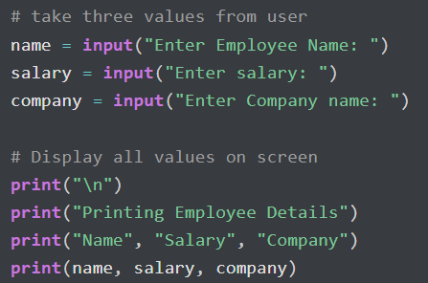
Input() in Python
In Python, Using the input() function, we take input from a user, and using the print() function, we display output on the screen.
Using the input() function, users can give any information to the application in the strings or numbers format.
Source :
https://pynative.com/python-input-function-get-user-input/
Notes:
In Python, Using the input() function, we take input from a user, and using the print() function, we display output on the screen.
Using the input() function, users can give any information to the application in the strings or numbers format.

Slide 28
Activity Time: Identify Variables and use Input() to read Value in it.
1) Create a program that takes the user's height and weight as input and calculates their Body Mass Index (BMI). Print the result in the format "Your BMI is [BMI]".
2) Write a program that takes two numbers as input from the user and prints their sum in the format "The sum of [number1] and [number2] is [sum]."
Notes:
Answer1:
height = float(input("Enter your height in meters: "))
weight = float(input("Enter your weight in kilograms: "))
bmi = weight / (height ** 2)
print(f"Your BMI is {bmi:.2f}")
Answer2:
number1 = float(input("Enter the first number: "))
number2 = float(input("Enter the second number: "))
sum_numbers = number1 + number2
print(f"The sum of {number1} and {number2} is {sum_numbers}.")

Slide 29
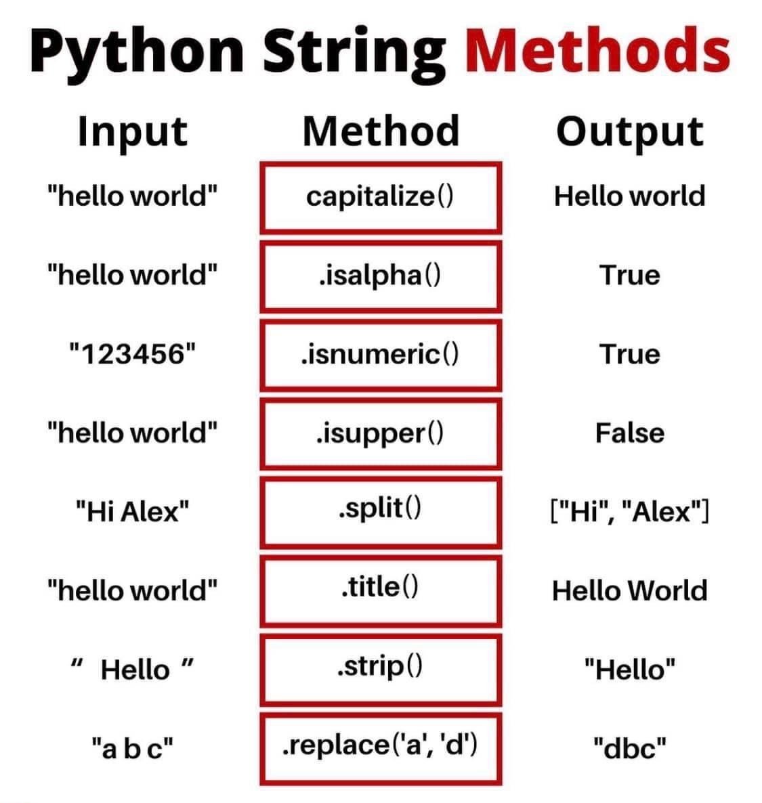
Strings in Python
The basic definition of python strings is we can say that it is a sequence of characters in python.
The Data Type of the text is str( String ).
Source :
https://www.scientecheasy.com/2023/01/string-slicing-in-python.html/
Notes:
A String is a data structure in Python Programming that represents a sequence of characters. It is an immutable data type, meaning that once you have created a string, you cannot change it. Python String are used widely in many different applications, such as storing and manipulating text data, representing names, addresses, and other types of data that can be represented as text.

Slide 30
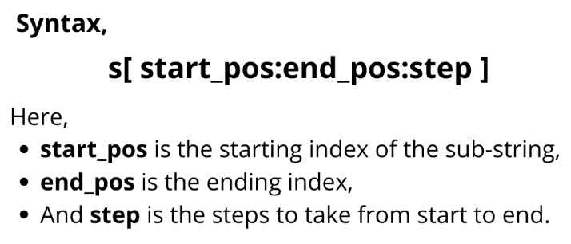
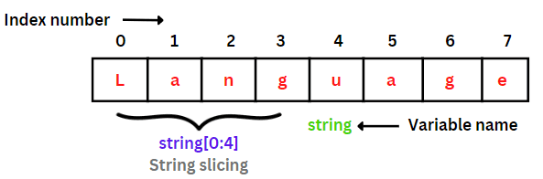
String Slicing in Python
Python supports string slicing. It is the creation of a new sub-string from a given string on the basis of the desired starting and ending indexes.
Source :
https://www.askpython.com/python/string/slice-strings-in-python
Notes:
Accessing characters in Python String
In Python Programming tutorials, individual characters of a String can be accessed by using the method of Indexing. Indexing allows negative address references to access characters from the back of the String, e.g. -1 refers to the last character, -2 refers to the second last character, and so on.
While accessing an index out of the range will cause an IndexError. Only Integers are allowed to be passed as an index, float or other types that will cause a TypeError.

Slide 31
Activity Time: Answer the Questions
1) You have a string full_name = “Edunet Foundation". Extract the first name and last name using string slicing.
2) Given the string sentence = "Python programming is fun", extract and print every second character from the string.
3) You have a string phrase = "Data Science is awesome!". Replace the word "awesome" with "amazing".
4) Given the string url = "https://www.example.com", remove the protocol part ("https://") using string slicing.
Notes:
Answer2:
sentence = "Python programming is fun"
every_second_char = sentence[::2]
print(every_second_char) # Output: Pto rgamn sfn
Answer3:
phrase = "Data Science is awesome!"
new_phrase = phrase.replace("awesome", "amazing")
print(new_phrase) # Output: Data Science is amazing!
Answer 4:
url = "https://www.example.com"
clean_url = url[8:] # Removing "https://"
print(clean_url) # Output: www.example.com

Slide 32
Lab Activity: Class Work
Lab 6: Hands-On with Python Strings and String Methods
Notes:
Lab: Hands-On with Python Strings and String Methods
Solution: GitHub Link

Slide 33
Different Types of Data Structures in Python
Data Structure defines how data is organized, stored, and manipulated within a program.
In Python, below are the Data Structures listed.
List
Tuples
Dictionaries
Sets
Notes:
Different types of Data Structures in Python :
In Python, there are several built-in and commonly used data structures. Here's an overview of some of the most important ones:
Lists: Lists are ordered collections of items, which can be of any data type. They are mutable, meaning their elements can be changed after creation. Lists are defined using square brackets []. Example: my_list = [1, 2, 3, 'a', 'b', 'c’].
Tuples: Tuples are similar to lists, but they are immutable, meaning their elements cannot be changed after creation. Tuples are defined using parentheses (). Example: my_tuple = (1, 2, 3, 'a', 'b', 'c’).
Dictionaries: Dictionaries are unordered collections of key-value pairs. They are indexed by unique keys and are highly efficient for lookups. Dictionaries are defined using curly braces {} with key-value pairs separated by colons :. Example: my_dict = {'name': 'John', 'age': 30, 'city': 'New York’}.
Sets: Sets are unordered collections of unique elements. They are defined using curly braces {} or by using the set() constructor. Sets are particularly useful for removing duplicates from a collection or checking for membership. Example: my_set = {1, 2, 3, 4, 5}.

Slide 34
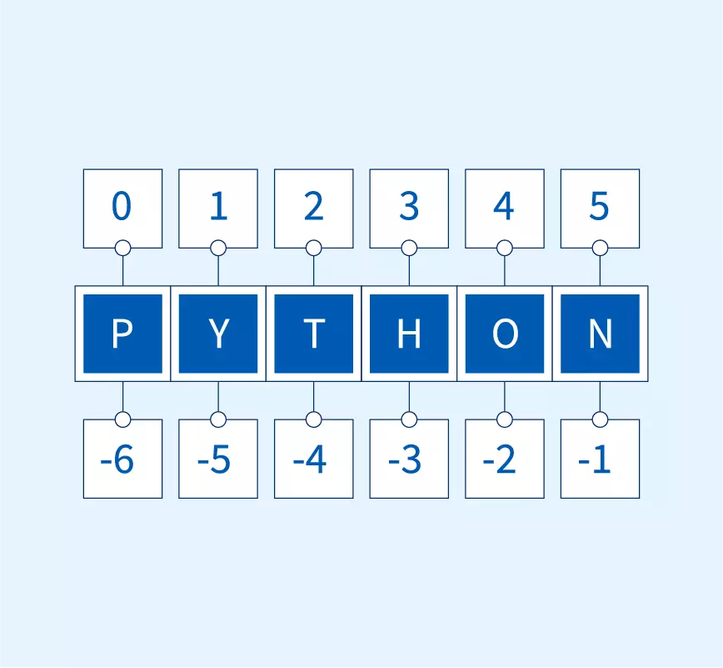
Python List
In Python, a list is a data structure that can hold a collection of values.
These values can be of any type – numbers, strings, other lists, and more.
Lists are ordered, which means the items in the list have a specific sequence, and you can access them by their position (index) in that sequence.​
Source :
https://www.scaler.com/topics/python/what-is-list-in-python/
Notes:
Python List:-
Most of our variables have one value in them - when we put a new value in the variable, the old value is overwritten
Ex:
>>> x = 2
>>> x = 4
>>> print(x)
4
List Constants
List constants are surrounded by square brackets and the elements in the list are separated by commas
A list element can be any Python object - even another list
A list can be empty
Sequences
Sequence: an object that contains multiple items of data
The items are stored in sequence one after another
Python provides different types of sequences, including lists and tuples
The difference between these is that a list is mutable and a tuple is immutable
Introduction to Lists
List: an object that contains multiple data items
Element: An item in a list
Format: list = [item1, item2, etc.]
Can hold items of different types
print function can be used to display an entire list
list() function can convert certain types of objects to lists
Repetition operator: makes multiple copies of a list and joins them together
The * symbol is a repetition operator when applied to a sequence and an integer
Sequence is left operand, number is right
General format: list * n
You can iterate over a list using a for loop
Format: for x in list:
An IndexError exception is raised if an invalid index is used
len function: returns the length of a sequence such as a list
Example: size = len(my_list)
Returns the number of elements in the list, so the index of last element is len(list)-1
Can be used to prevent an IndexError exception when iterating over a list with a loop
Mutable sequence: the items in the sequence can be changed
Lists are mutable, and so their elements can be changed
An expression such as
list[1] = new_value can be used to assign a new value to a list element
Must use a valid index to prevent raising of an IndexError exception
Concatenate: join two things together
The + operator can be used to concatenate two lists
Cannot concatenate a list with another data type, such as a number
The += augmented assignment operator can also be used to concatenate lists
Slice: a span of items that are taken from a sequence
List slicing format: list[start : end]
Span is a list containing copies of elements from start up to, but not including, end
If start not specified, 0 is used for start index
If end not specified, len(list) is used for end index
Slicing expressions can include a step value and negative indexes relative to end of list

Slide 35
Activity Time: Answer the Questions
1) Given the list of students' names: students = ["Alice", "Bob", "Charlie", "David", "Eve"], reverse the order of the list.
2) You have a list items = ["apple", "banana", "cherry", "date", "fig", "grape"]. Extract all items from "cherry" to "fig" using list slicing.
3) You have a list fruits = ["apple", "banana", "cherry", "date", "fig", "grape"]. Add a new fruit "kiwi" at the 3rd position.
4) Given a list of ages: ages = [23, 45, 18, 34, 60, 50, 27], calculate the average age.
Notes:
Answer1:
students = ["Alice", "Bob", "Charlie", "David", "Eve"]
reversed_students = students[::-1]
print(reversed_students) # Output: ['Eve', 'David', 'Charlie', 'Bob', 'Alice’]
Answer2:
items = ["apple", "banana", "cherry", "date", "fig", "grape"]
selected_items = items[2:5]
print(selected_items) # Output: ['cherry', 'date', 'fig’]
Answer 3:
fruits = ["apple", "banana", "cherry", "date", "fig", "grape"]
fruits.insert(2, "kiwi")
print(fruits) # Output: ['apple', 'banana', 'kiwi', 'cherry', 'date', 'fig', 'grape’]
Answer 4:
ages = [23, 45, 18, 34, 60, 50, 27]
average_age = sum(ages) / len(ages)
print(average_age) # Output: 36.714285714285715

Slide 36
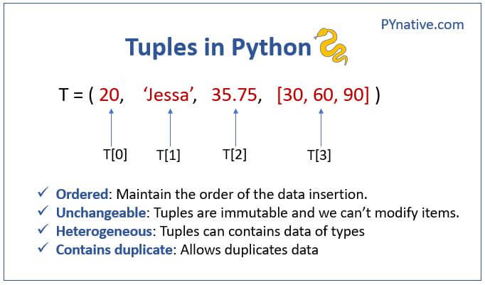
Python Tuple
Tuple: an immutable sequence
  Very similar to a list
  Once it is created it cannot be changed
  Tuples support operations as lists
    Subscript indexing for retrieving elements
    Methods such as index
    Built in functions such as len, min, max
Source :
https://pynative.com/python-tuples/
Notes:
Python Tuple:
Tuples do not support the methods:
append
remove
insert
reverse
sort
Advantages for using tuples over lists:
Processing tuples is faster than processing lists
Tuples are safe
Some operations in Python require use of tuples
list() function: converts tuple to list
tuple() function: converts list to tuple

Slide 37
Activity Time: Answer the Questions
1) Given the tuple of students' names: students = ("Alice", "Bob", "Charlie", "David", "Eve“), reverse the order of the list.
2) You have a tuple items = ("apple", "banana", "cherry", "date", "fig", "grape“). Extract all items from "cherry" to "fig" using list slicing.
3) You have a tuple fruits = ("apple", "banana", "cherry", "date", "fig", "grape“). Add a new fruit "kiwi" at the 3rd position.
4) Given a tuple of ages: ages = (23, 45, 18, 34, 60, 50, 27), calculate the average age.
Notes:
Answer1:
students = ["Alice", "Bob", "Charlie", "David", "Eve"]
reversed_students = students[::-1]
print(reversed_students) # Output: ['Eve', 'David', 'Charlie', 'Bob', 'Alice’]
Answer2:
items = ["apple", "banana", "cherry", "date", "fig", "grape"]
selected_items = items[2:5]
print(selected_items) # Output: ['cherry', 'date', 'fig’]
Answer 3:
fruits = ["apple", "banana", "cherry", "date", "fig", "grape"]
fruits.insert(2, "kiwi")
print(fruits) # Output: ['apple', 'banana', 'kiwi', 'cherry', 'date', 'fig', 'grape’]
Answer 4:
ages = [23, 45, 18, 34, 60, 50, 27]
average_age = sum(ages) / len(ages)
print(average_age) # Output: 36.714285714285715

Slide 38
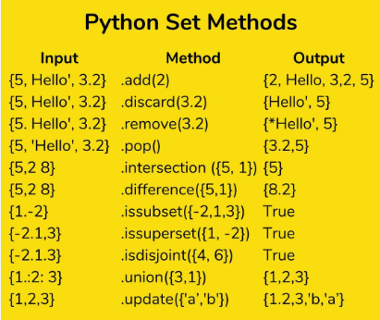
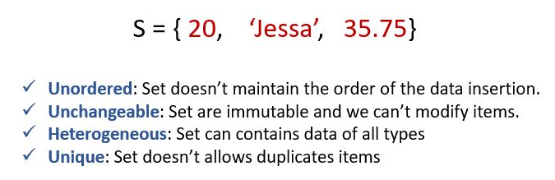
Sets in Python
Source :
https://pynative.com/python-sets/
Notes:
A Set in Python programming is an unordered collection data type that is iterable, mutable and has no duplicate elements.
Set are represented by { } (values enclosed in curly braces)
The major advantage of using a set, as opposed to a list, is that it has a highly optimized method for checking whether a specific element is contained in the set. This is based on a data structure known as a hash table. Since sets are unordered, we cannot access items using indexes as we do in lists.

Slide 39
Activity Time: Answer the Questions
You have two sets of student names who attended two different workshops:
workshop1 = {"Alice", "Bob", "Charlie", "David"}
workshop2 = {"Eve", "Bob", "Frank", "David"}
Write a program to find and print the names of students who attended both workshops.
Write a program to find and print the names of students unio to both wirkshops.
Notes:
workshop1 = {"Alice", "Bob", "Charlie", "David"}
workshop2 = {"Eve", "Bob", "Frank", "David"}
attended_both = workshop1.intersection(workshop2)
print(f"Students who attended both workshops: {attended_both}")

Slide 40
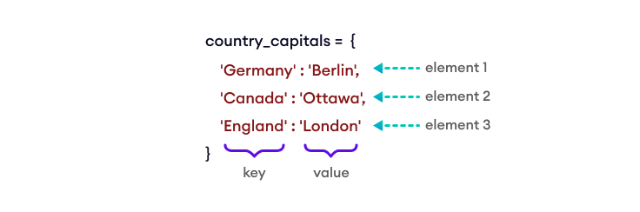
Python Dictionary
A Python dictionary is a collection of items, similar to lists and tuples. However, unlike lists and tuples, each item in a dictionary is a key-value pair (consisting of a key and a value).
Source :
https://www.programiz.com/python-programming/dictionary
Notes:
Create a Dictionary
------------------------------------------------------------------------------------------------------------------------------------------------------------------------
We create a dictionary by placing key: value pairs inside curly brackets {}, separated by commas. For example,
Notes:
Dictionary keys must be immutable, such as tuples, strings, integers, etc. We cannot use mutable (changeable) objects such as lists as keys.
We can also create a dictionary using a Python built-in function dict(). To learn more, visit Python dict().

Slide 41
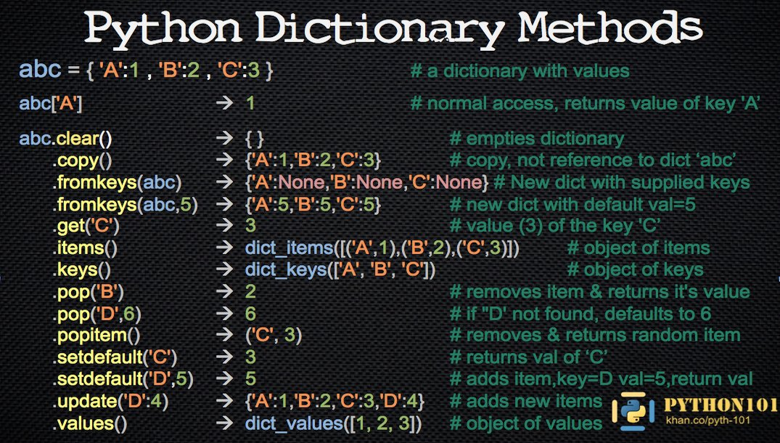
Python Dictionary Methods
Source :
https://x.com/OlofPaulson/status/1368503322169253888/photo/1
Notes:
Here are the Python dictionary methods. All the methods are explained with an example by looking at the image you can understand.

Slide 42
Activity Time: Answer the Questions
1) Create a dictionary student with keys "name", "age", and "grades" (a list of integers). Print the dictionary.
2) Add a new key-value pair to the student dictionary with the key "major" and the value "Computer Science". Print the updated dictionary.
3) Calculate and print the average grade from the "grades" list in the student dictionary.
Notes:
Answer1:
student = {"name": "John", "age": 20, "grades": [85, 90, 78]}
print(student)
# Output: {'name': 'John', 'age': 20, 'grades': [85, 90, 78]}
Answer 2:
student["major"] = "Computer Science"
print(student)
# Output: {'name': 'John', 'age': 20, 'grades': [85, 90, 78], 'major': 'Computer Science’}
Answer3:
average_grade = sum(student["grades"]) / len(student["grades"])
print(f"Average grade: {average_grade}")
# Output: Average grade: 84.33333333333333

Slide 43
Lab Activity: Class Work
Lab 7: Python Lists, Tuples, Dictionaries,and Sets
Notes:
Lab. Python Lists, Tuples, Dictionaries,and Sets
Solution: GitHub Link

Slide 44
Self Practice-2
Self Practice 2: Better understanding of Python Data Structures
Notes:
Self-Practice: Better understanding of Python Data Structures
Solution: GitHub Link

Slide 45
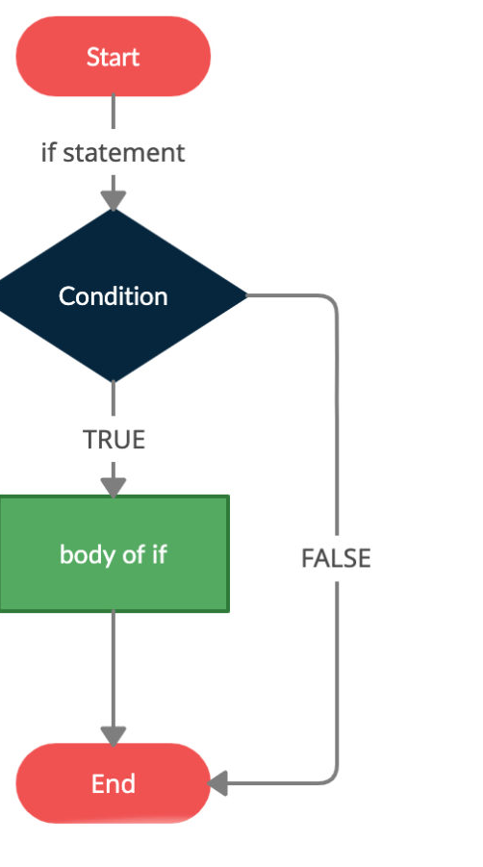
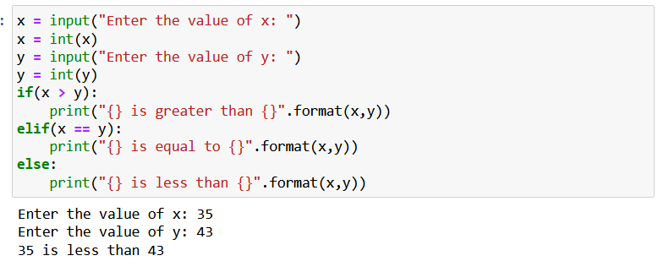
If, Elif & Else Statement in Python
Source :
https://www.toppr.com/guides/python-guide/tutorials/python-flow-control/if-elif-else/python-if-if-else-if-elif-else-and-nested-if-statement/
Notes:
Like in other programming languages like C. Java, and C++, in Python also we have control statements like if. if else. Now let's have a discuss about these control statements.
----------------------
Certainly! In Python, if and if-else are conditional statements that allow you to control the flow of your program based on certain conditions. These statements are used to execute different parts of code depending on whether a given condition is True or False.
if and if-else statements are essential for making decisions in your code based on specific conditions. You can also use more complex combinations of if, elif (short for "else if"), and else to handle multiple possible conditions in your program.

Slide 46
Activity Time: Answer the Questions
1) Write a program that checks if a given number is positive, negative, or zero and prints the appropriate message.
2) Write a program that takes a user's age and checks if they are a child (0-12 years), a teenager (13-19 years), an adult (20-64 years), or a senior (65+ years), and prints the appropriate message.
Notes:
Answer1:
number = int(input("Enter a number: "))
if number > 0:
print("The number is positive.")
elif number < 0:
print("The number is negative.")
else:
print("The number is zero.")
Answer2:
age = int(input("Enter your age: "))
if age >= 0 and age <= 12:
print("You are a child.")
elif age >= 13 and age <= 19:
print("You are a teenager.")
elif age >= 20 and age <= 64:
print("You are an adult.")
elif age >= 65:
print("You are a senior.")
else:
print("Invalid age.")

Slide 47
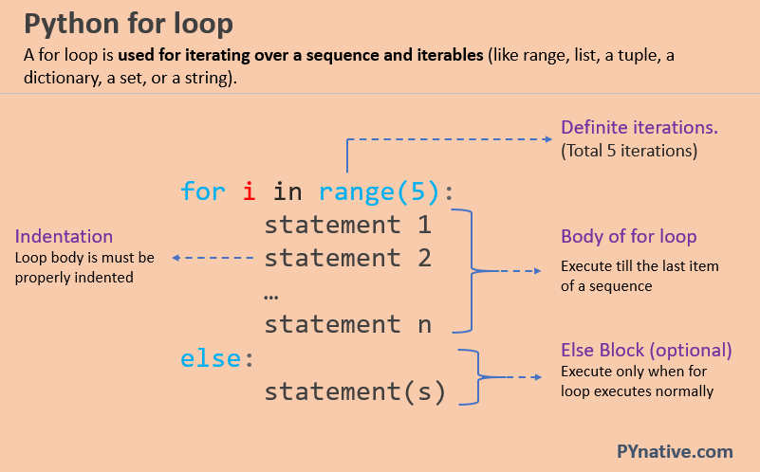
For loop in Python
Source :
https://pynative.com/python-for-loop/
Notes:
Like other programming languages in Python also we have looping statements. In Python we have for loop and while loop but the syntax is different compared to other programming languages. Let's have dive into these loop control statements.
-----
In Python, the for loop is used to iterate over a sequence such as a list, string, tuple, other iterable objects such as range.
With the help of for loop, we can iterate over each item present in the sequence and executes the same set of operations for each item. Using a for loops in Python we can automate and repeat tasks in an efficient manner.

Slide 48
Activity Time: Answer the questions
1) Write a program that takes a dictionary of student names and their scores, and prints the grade of each student based on the score (A for 90+, B for 80-89, C for 70-79, D for 60-69, F for below 60).
2) Write a program that takes a tuple of numbers and prints whether each number is even or odd.
Notes:
Answer 1:
student_scores = {"Alice": 95, "Bob": 82, "Charlie": 78, "David": 65, "Eve": 58}
for student, score in student_scores.items():
if score >= 90:
grade = 'A'
elif score >= 80:
grade = 'B'
elif score >= 70:
grade = 'C'
elif score >= 60:
grade = 'D'
else:
grade = 'F'
print(f"{student} received grade {grade}")
Answer2:
numbers = (1, 2, 3, 4, 5, 6)
for number in numbers:
if number % 2 == 0:
print(f"{number} is even.")
else:
print(f"{number} is odd.")

Slide 49
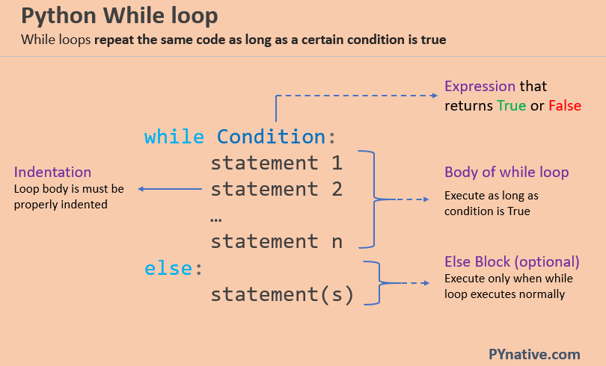
While loop in Python
Source :
https://pynative.com/python-while-loop/
Notes:
In previous slide we have seen what is for loop in Python point of view now let's have a look at while loop in Python.
------
The while statement checks the condition. The condition must return a boolean value. Either True or False.
Next, If the condition evaluates to true, the while statement executes the statements present inside its block.
The while statement continues checking the condition in each iteration and keeps executing its block until the condition becomes false.

Slide 50
Activity Time: Answer the Questions
1) Write a program that repeatedly asks the user for a number and adds it to a list until the sum of the list is greater than 100. Print the list and the sum.
2) Given a tuple of numbers, write a program that prints each element in reverse order using a while loop.
Notes:
Answer 1:
numbers = []
total = 0
while total <= 100:
num = int(input("Enter a number: "))
numbers.append(num)
total += num
print(f"List of numbers: {numbers}")
print(f"Sum of the list: {total}")
Answer2:
numbers = (1, 2, 3, 4, 5)
index = len(numbers) - 1
while index >= 0:
print(numbers[index])
index -= 1

Slide 51
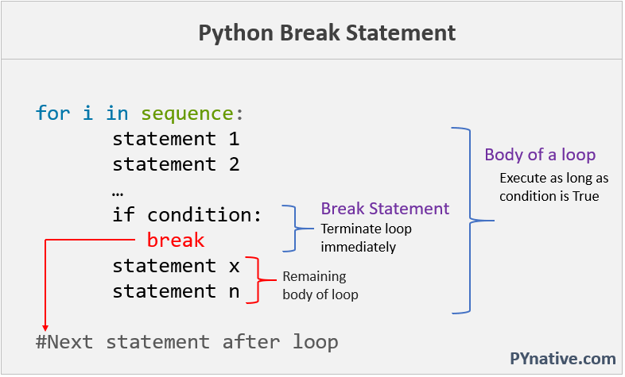
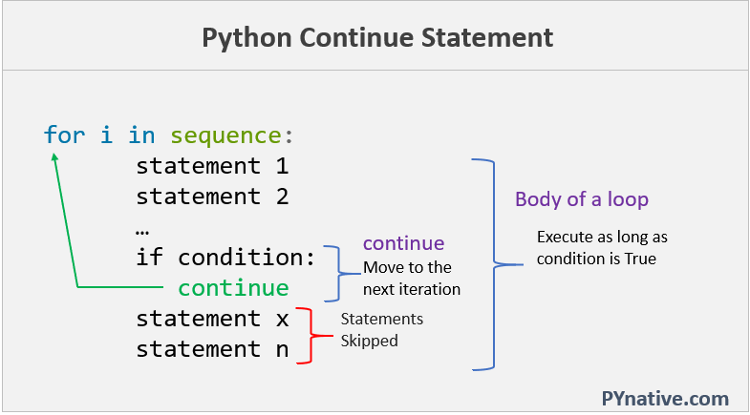
Break, and Continue Statements
Source :
https://pynative.com/python-break-continue-pass/
Notes:
Certainly! break and continue are control flow statements in Python that are often used within loops (for and while) to modify the loop's behavior. Let's have a look at those.
------------------------
break Statement: The break statement is used to exit the loop prematurely. When a break statement is encountered within a loop, the loop terminates immediately, regardless of whether the loop's condition has been fully satisfied.
continue Statement: The continue statement is used to skip the current iteration of the loop and move to the next iteration. It effectively skips the rest of the code in the current iteration and jumps to the next iteration.

Slide 52
Activity Time: Answer the Questions
1) Given a list of strings, write a program that checks if the list contains any empty strings. If it does, print "List contains empty strings", otherwise print "No empty strings found".
2) Write a program that repeatedly asks the user to input a number until they input a negative number. Print the total count of numbers entered (excluding the negative number).
Notes:
Answer 1:
strings = ["hello", "", "world", "python"]
contains_empty = False
for s in strings:
if s == "":
contains_empty = True
break
if contains_empty:
print("List contains empty strings.")
else:
print("No empty strings found.")
Answer2:
count = 0
while True:
num = int(input("Enter a number: "))
if num < 0:
break
count += 1
print(f"Total numbers entered: {count}")

Slide 53
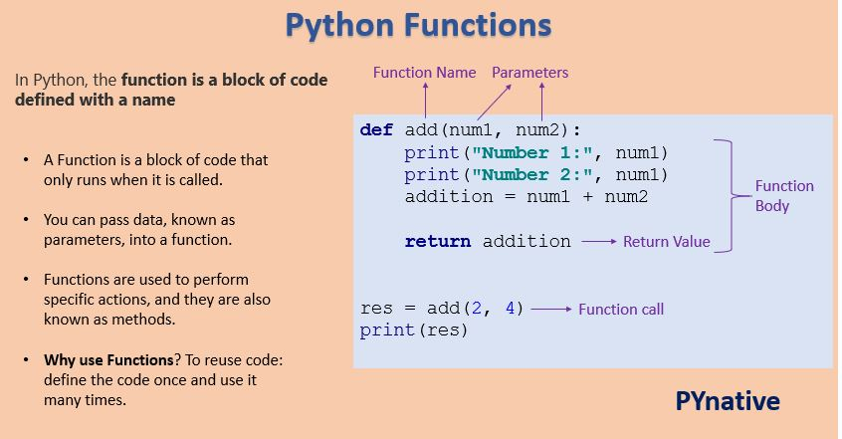
Functions in Python
Source :
https://pynative.com
Notes:
function_name: Function name is the name of the function. We can give any name to function.
parameter: Parameter is the value passed to the function. We can pass any number of parameters. Function body uses the parameter’s value to perform an action
function_body: The function body is a block of code that performs some task. This block of code is nothing but the action you wanted to accomplish.
return value: Return value is the output of the function.

Slide 54
Activity Time: Answer the Questions
1) Write a function calculate_average that takes a list of numbers as an argument and returns the average of the numbers. Then, use this function to calculate the average of a list of scores.
2) Write a function multiply_list that takes a list of numbers and a multiplier as arguments and returns a new list with each number multiplied by the multiplier. Then, use this function to multiply a list of prices by 1.2 (to add 20% tax).
Notes:
Answer 1:
def calculate_average(numbers):
total = sum(numbers)
count = len(numbers)
average = total / count
return average
scores = [88, 92, 79, 93, 85]
avg_score = calculate_average(scores)
print(f"Average score: {avg_score}")
# Output: Average score: 87.4
Answer2:
def multiply_list(numbers, multiplier):
result = []
for number in numbers:
result.append(number * multiplier)
return result
prices = [10, 20, 30, 40, 50]
new_prices = multiply_list(prices, 1.2)
print(new_prices)
# Output: [12.0, 24.0, 36.0, 48.0, 60.0]

Slide 55
Lab Activity: Class Work
Lab 8: Demonstrating Python programs on control statements looping statements and functions
Notes:
Lab : Demonstrating Python programs on control statements looping statements and functions
Solution: GitHub Link

Slide 56
Self Practice
Self Practice-3 Python programs on control statements looping statements and functions
Notes:
Self Practice : Python programs on control statements looping statements and functions
Solution: GitHub Link

Slide 57
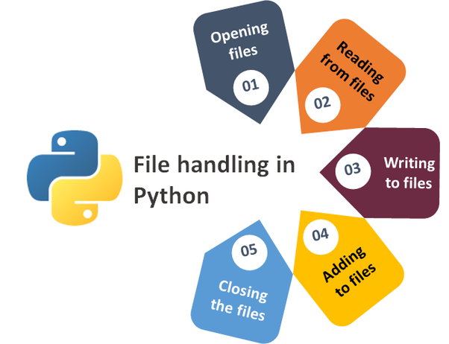
File Handling
Definition:
File handling in Python is the process of reading, writing, and manipulating files using Python code.
Source :
https://abuqaiselegant.medium.com/python-file-handling-760887773bd7
Notes:
File Handling
------------------------------------------------------------------------------------------------------------------------------------------------------------------------------
There are many different ways to handle files in Python, but the most common approach is to use the built-in open() function. This function allows you to open a file for reading, writing, or appending. Once you have opened a file, you can use the read(), write(), and append() methods to read from, write to, or append to the file, respectively.
When you are finished with a file, it is important to close it using the close() method. This will ensure that all of the data in the file is properly saved and that the file is not corrupted.

Slide 58
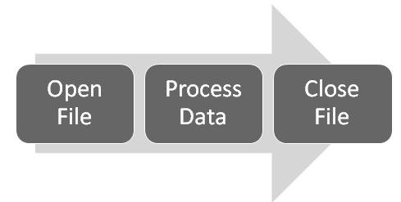
Flow of File handling
Source :
https://geospatialtraining.com/file-handling-with-python-for-gis-programmers/
Notes:
Flow of file handling
To use Python’s built in file processing function you must first open the file. Once open, data within the file is processed using functions provided by Python, and finally the file is closed. Always remember to close the file when you’re done.

Slide 59
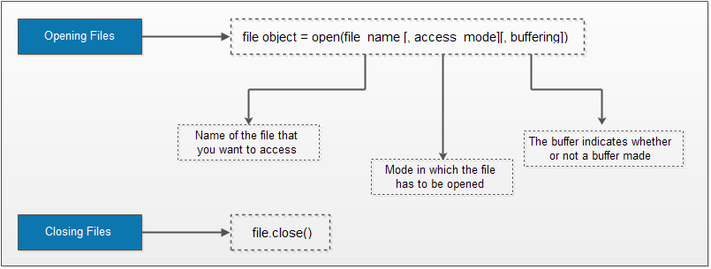
Opening a File
Opening a file is the fundamental step in every file types handling a task.
Files in Python can be opened with a built-in open() function. Ideally, it takes two string arguments:
Filename
Mode
Source :
https://ecomputernotes.com/python/file-handling-in-python
Notes:
Opening a File
To read or write a file, we need to open that file. For this purpose, Python provides a built-in function open().
Pass file path and access mode to the open(file_path, access_mode) function. It returns the file object. This object is used to read or write the file according to the access mode.

Slide 60
Access Method
Access Mode |  | Description
Text File | Binary file
r | rb | Read
a | ab | Append
w | wb | Write
x | xb | Create
r+ | rb+ | read and write
a+ | ab+ | append and read
w+ | wb+ | write and read
Notes:
Access Method
r means to read. So, it opens a file for read-only operation. The file pointer exists at the beginning. The file is by default open in this mode if no access mode is passed.
rb It opens the file to read-only in binary format. The file pointer exists at the beginning of the file.
r+ It opens the file to read and write both. The file pointer exists at the beginning of the file.
rb+ It opens the file to read and write both in binary format. The file pointer exists at the beginning of the file.
w It opens the file to write only. It overwrites the file if previously exists or creates a new one if no file exists with the same name. The file pointer exists at the beginning of the file.
wb It opens the file to write only in binary format. It overwrites the file if it exists previously or creates a new one if no file exists. The file pointer exists at the beginning of the file.
w+ It opens the file to write and read both. It is different from r+ in the sense that it overwrites the previous file if one exists whereas r+ doesn't overwrite the previously written file. It creates a new file if no file exists. The file pointer exists at the beginning of the file.
wb+ It opens the file to write and read both in binary format. The file pointer exists at the beginning of the file.
a It opens the file in the append mode. The file pointer exists at the end of the previously written file if exists any. It creates a new file if no file exists with the same name.
ab It opens the file in the append mode in binary format. The pointer exists at the end of the previously written file. It creates a new file in binary format if no file exists with the same name.
a+ It opens a file to append and read both. The file pointer remains at the end of the file if a file exists. It creates a new file if no file exists with the same name.
ab+ It opens a file to append and read both in binary format. The file pointer remains at the end of the file.

Slide 61
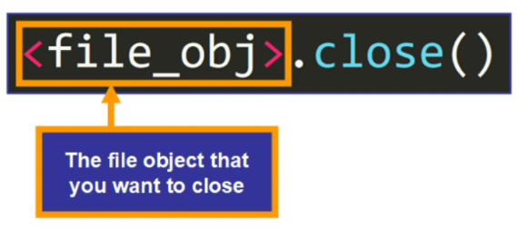
Closing a File
It is a good practice to always close the file when you are done with it.
Syntax:
fileobject.close()
Source :
https://www.scaler.com/topics/close-file-python/
Notes:
The close() Method
The close method used to terminate the program. Once all the operations are done on the file, we must close it through our Python script using the close() method. Any unwritten information gets destroyed once the close() method is called on a file object.

Slide 62
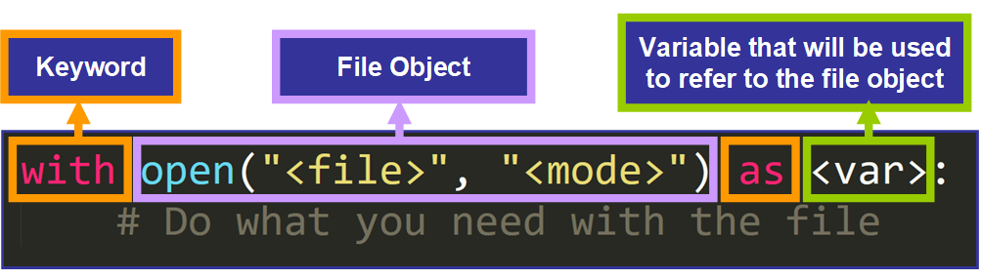
With Statement
With statement is used in exception handling to make the code cleaner and much more readable.
It simplifies the management of common resources like file streams.
Notes:
With statement
The with statement is useful in the case of manipulating the files. It is used in the scenario where a pair of statements is to be executed with a block of code in between.
The advantage of using with statement is that it provides the guarantee to close the file regardless of how the nested block exits.
It is always suggestible to use the with statement in the case of files because, if the break, return, or exception occurs in the nested block of code then it automatically closes the file, we don't need to write the close() function. It doesn't let the file to corrupt.

Slide 63
Activity Time: Answer the questions
1) Write a program that writes a list of tuples, each containing a student's name and grade, to a text file. Each line in the file should contain the student's name and grade separated by a comma. Assume the file is named grades.txt.
2) Write a program that reads a CSV file containing product names and their prices, then calculates and prints the total cost of all products. Assume the file is named products.csv and has the format: ProductName,Price.
Notes:
Answer 1:
def write_grades_to_file(filename, grades):
with open(filename, 'w') as file:
for student, grade in grades:
file.write(f"{student},{grade}\n")
student_grades = [("Alice", "A"), ("Bob", "B"), ("Charlie", "C")]
write_grades_to_file('grades.txt', student_grades)
# Output in grades.txt:
# Alice,A
# Bob,B
# Charlie,C
Answer2:
def calculate_total_cost(filename):
total_cost = 0
with open(filename, 'r') as file:
for line in file:
product, price = line.strip().split(',')
total_cost += float(price)
print(f"Total cost: ${total_cost:.2f}")
calculate_total_cost('products.csv')
# If products.csv contains:
# Laptop,800
# Mouse,25
# Keyboard,45
# Monitor,150
# Output: Total cost: $1020.00

Slide 64
Lab Activity: Class Work
Lab 9: Demonstrating Python file handling
Notes:
Lab : Demonstrating Python data structures and file handling
GITHUB

Slide 65
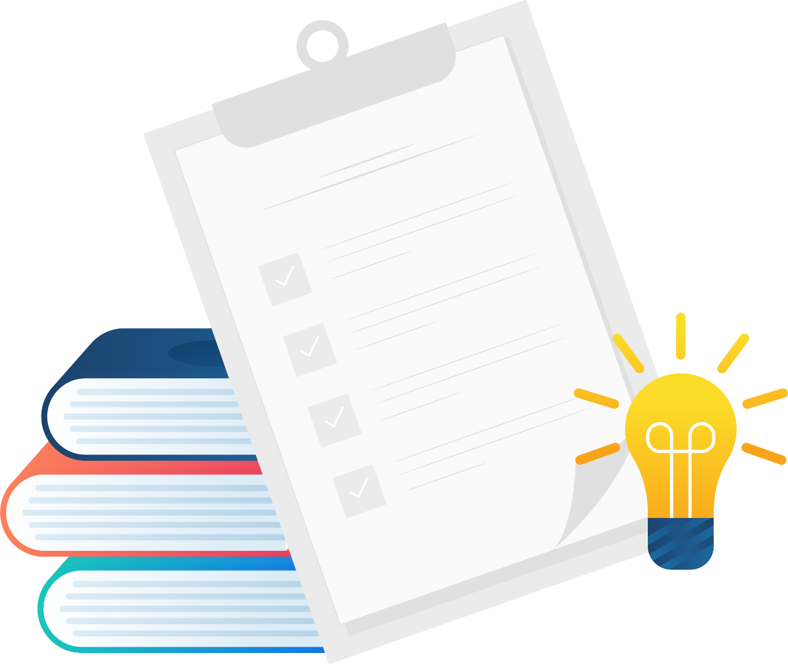
Summary
You will learn in this Chapter:
Let's summarize our learnings:
Code and Compilation: Python is an interpreted language with code executed line by line.
Datatypes and Operators: Includes types like int, float, str, and operators for arithmetic, comparison, and logic.
Control Statements: Uses if, elif, and else for decision-making.
Looping Statements: Utilizes for and while loops for iteration.
Functions: Defined with def, used to encapsulate reusable code blocks.
File Handling: Involves opening, reading, writing, and closing files with built-in functions.
Notes:
Summary​
--------------------------------------------------------------------------------------------------------------------------------------------------------------------------------------------------​
Well done! You have completed this course and now you have understand about:
Code and Compilation: Python is an interpreted language with code executed line by line.
Datatypes and Operators: Includes types like int, float, str, and operators for arithmetic, comparison, and logic.
Control Statements: Uses if, elif, and else for decision-making.
Looping Statements: Utilizes for and while loops for iteration.
Functions: Defined with def, used to encapsulate reusable code blocks.
File Handling: Involves opening, reading, writing, and closing files with built-in functions.

Slide 66
Reference
https://www.analyticsvidhya.com/blog/2021/05/introduction-to-python-programming-beginners-guide/
https://www.programiz.com/python-programming
https://www.w3schools.com/python/python_intro.asp
https://www.javatpoint.com/python-tutorial
https://www.geeksforgeeks.org/file-handling-python/
https://www.w3schools.com/python/python_file_handling.asp
https://www.javatpoint.com/python-files-io

Slide 67

?
QUIZ

Slide 68

Quiz
?
All keywords in Python are in _________
Capitalized
lower case
UPPER CASE
None of the mentioned​
Answer: D
​None of the mentioned​
Notes:
1. All keywords in Python are in _________
a) Capitalized
b) lower case
c) UPPER CASE
d) None of the mentioned
Answer: d

Slide 69
Quiz
?
2. What arithmetic operators cannot be used with strings in Python?
*
–
+
All of the mentioned
Answer: B
​ –
Notes:
3. What arithmetic operators cannot be used with strings in Python?
a) *
b) –
c) +
d) All of the mentioned
Answer: b

Slide 70
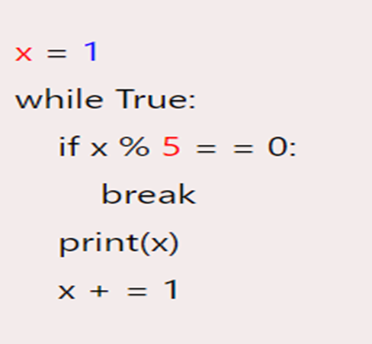
Quiz
?
3. What will be the output of this code?
error
2 1
0 3 1
None of these
3. Study the following program:
Answer: A
error
Notes:
Now let's have a look at the third question from the quiz.
3 Study the following program: please follow the code which is provided in this slide
What will be the output of this code?
1.error
2.2 1
3.0 3 1
4.None of these
Answer: A

Slide 71
Quiz
?
5) Which character is used in Python to make a single line comment?
/
//
#
!
Answer: C
​#
Notes:
1)Which character is used in Python to make a single line comment?
A) /
B) //
C) #
D) !
Answer: C

Slide 72
Thank You

